Slide 1
Metaverse
IT course 2023
Dr. Basiri
Diba Mirshafiei

Slide 2
Topics
Definition and Evolution of the Metaverse
History of the Metaverse
Technological Underpinnings of the Metaverse
How the Metaverse Works
Potential Applications of the Metaverse
Challenges and Opportunities of the Metaverse:

Slide 3
Topics
Definition and Evolution of the Metaverse
History of the Metaverse
Technological Underpinnings of the Metaverse
How the Metaverse Works
Potential Applications of the Metaverse
Challenges and Opportunities of the Metaverse:

Slide 4
Definition and Evolution of the Metaverse
Shared virtual space
Unified virtal space
Next step!
Interactive

Slide 5
Topics
Definition and Evolution of the Metaverse
History of the Metaverse
Technological Underpinnings of the Metaverse
How the Metaverse Works
Potential Applications of the Metaverse
Challenges and Opportunities of the Metaverse:

Slide 6

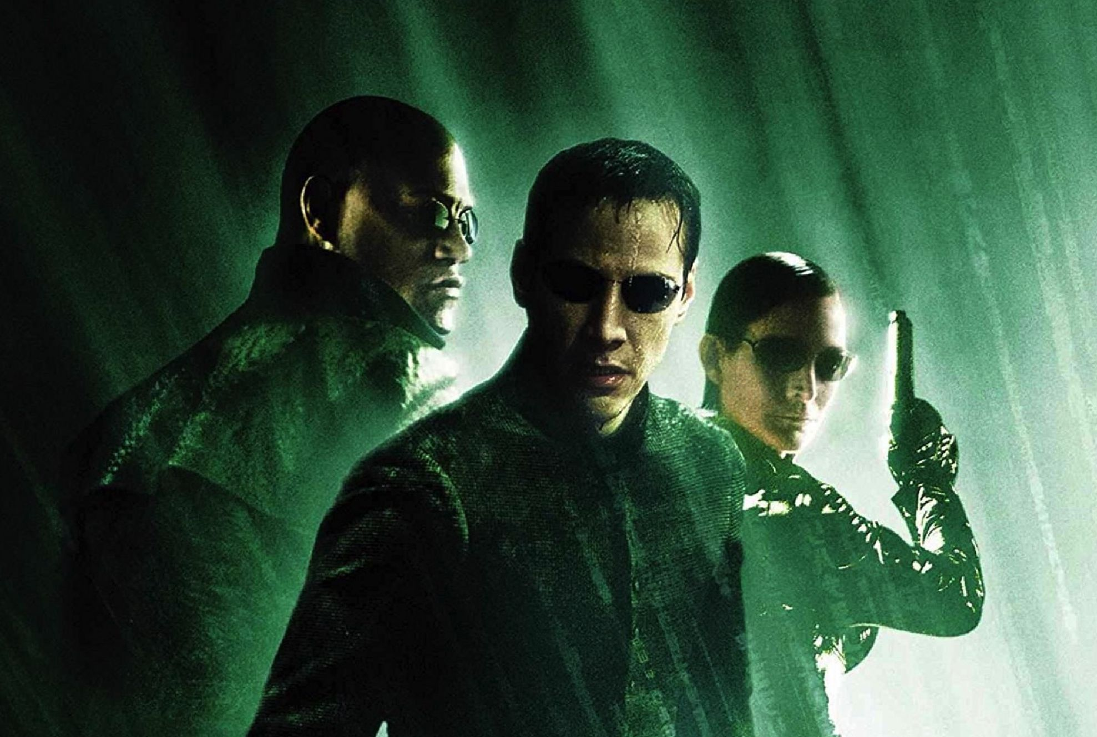
History of the Metaverse
Snow Crash (Neal Stephenson)/The Matrix

Slide 7
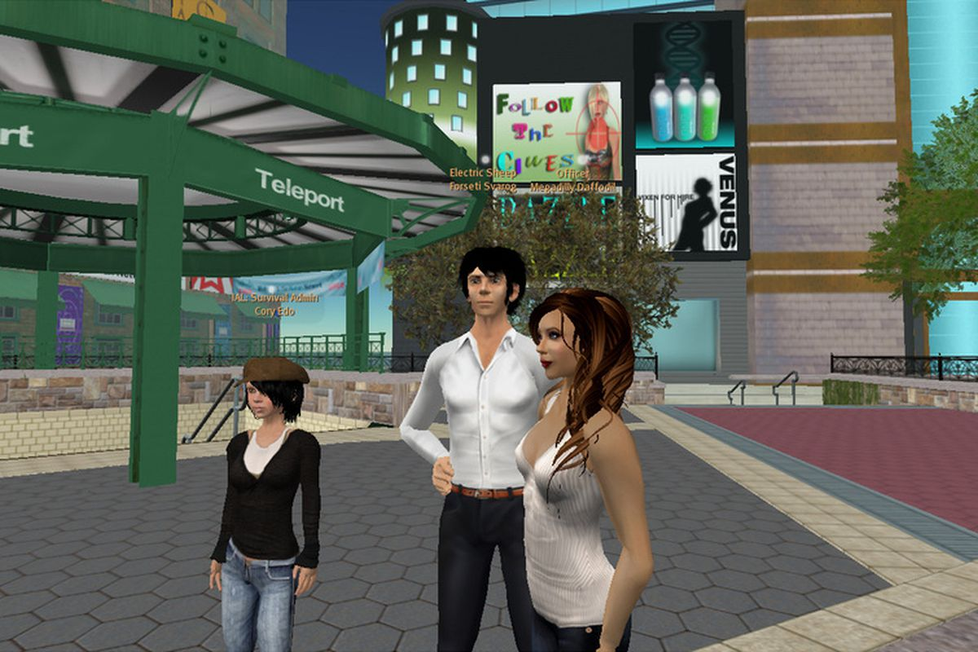
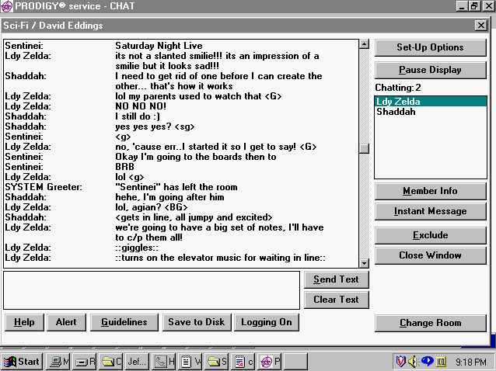
History of the Metaverse
Early days -> Online Chats / forums / Online Games
2003 -> Second Life

Slide 8
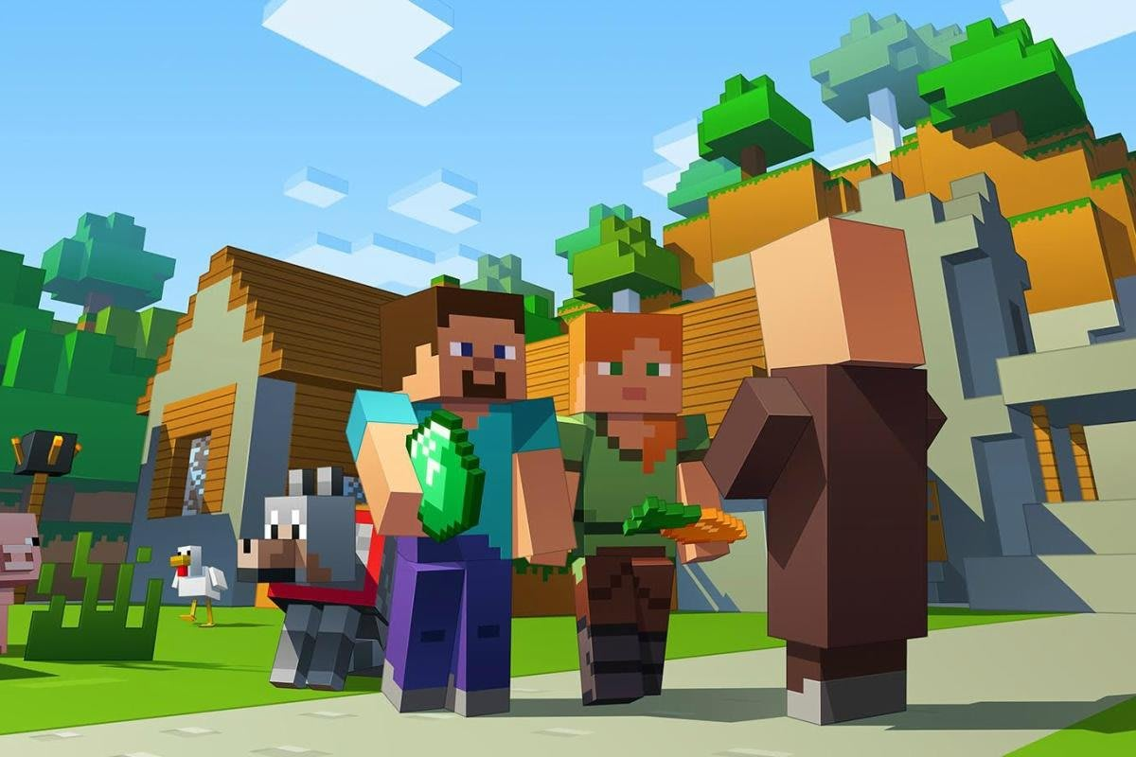

History of the Metaverse
Warcraft/ Minecraft / VRChat
Today -> FaceBook(Meta)/Roblox/Decentraland

Slide 9
Topics
Definition and Evolution of the Metaverse
History of the Metaverse
Technological Underpinnings of the Metaverse
How the Metaverse Works
Potential Applications of the Metaverse
Challenges and Opportunities of the Metaverse:

Slide 10
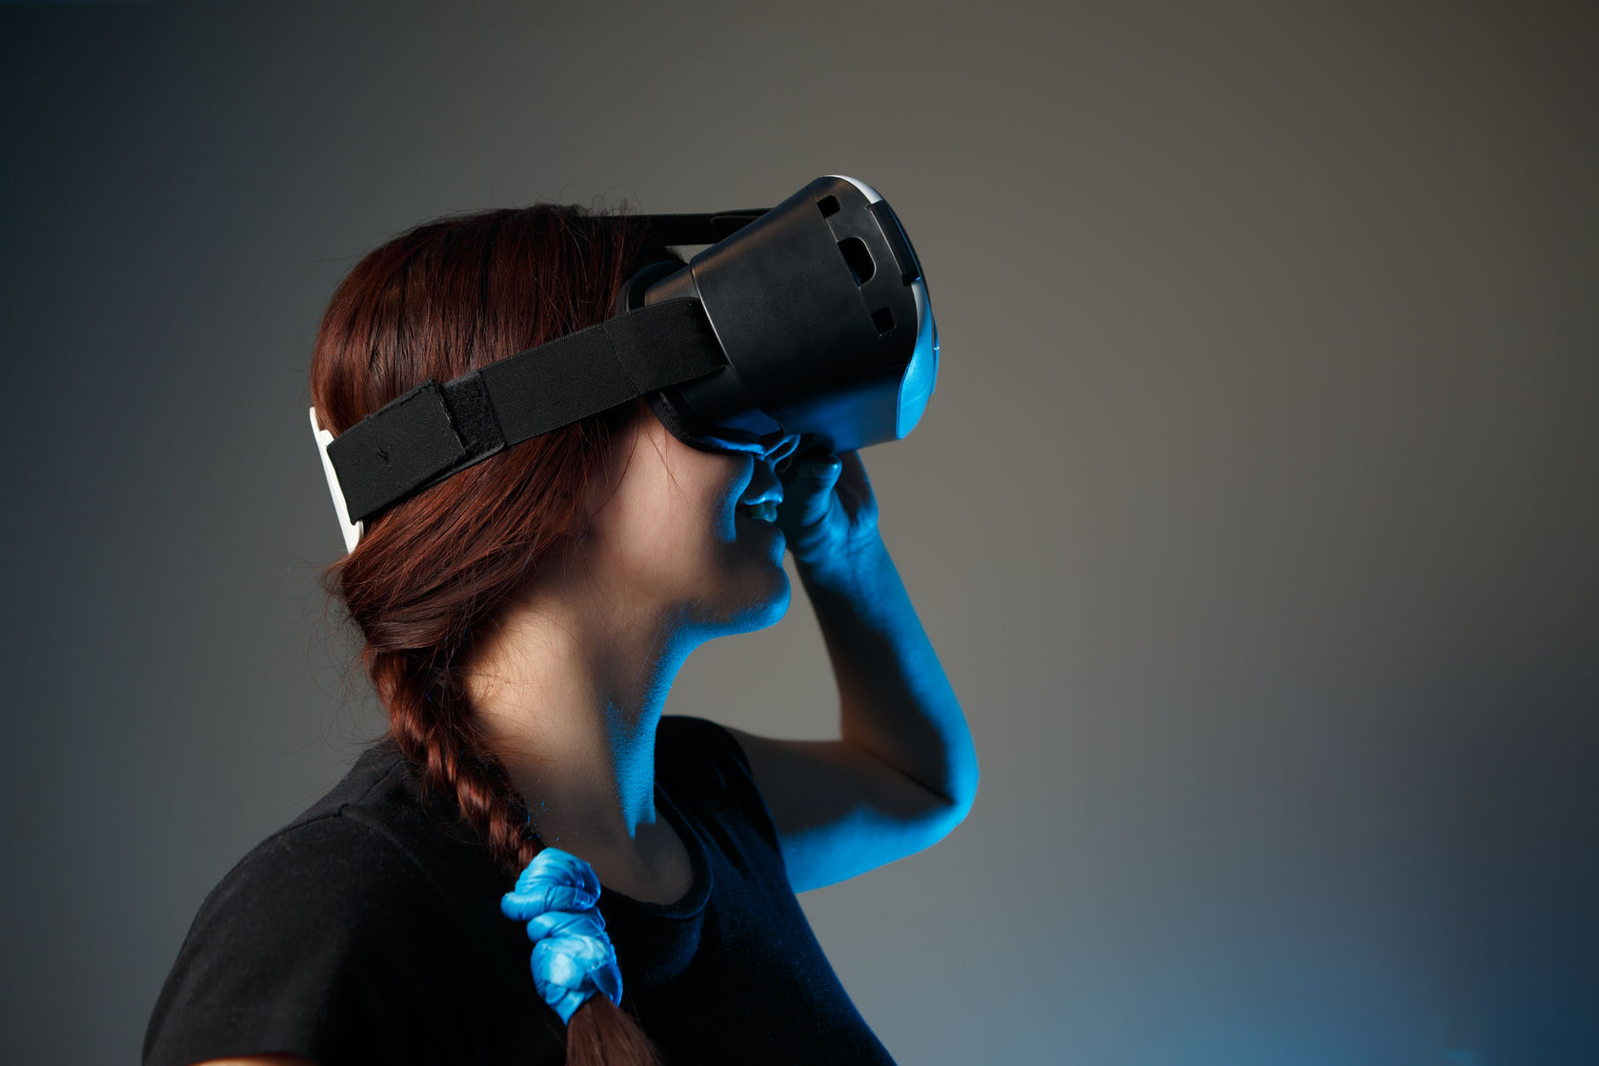
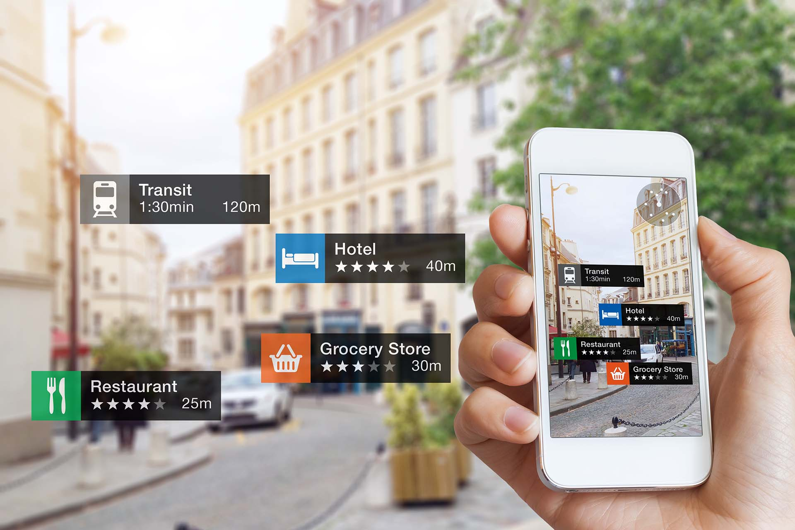
Technological Underpinnings of the Metaverse
Virtual Reality (VR) / Augmented Reality (AR)

Slide 11
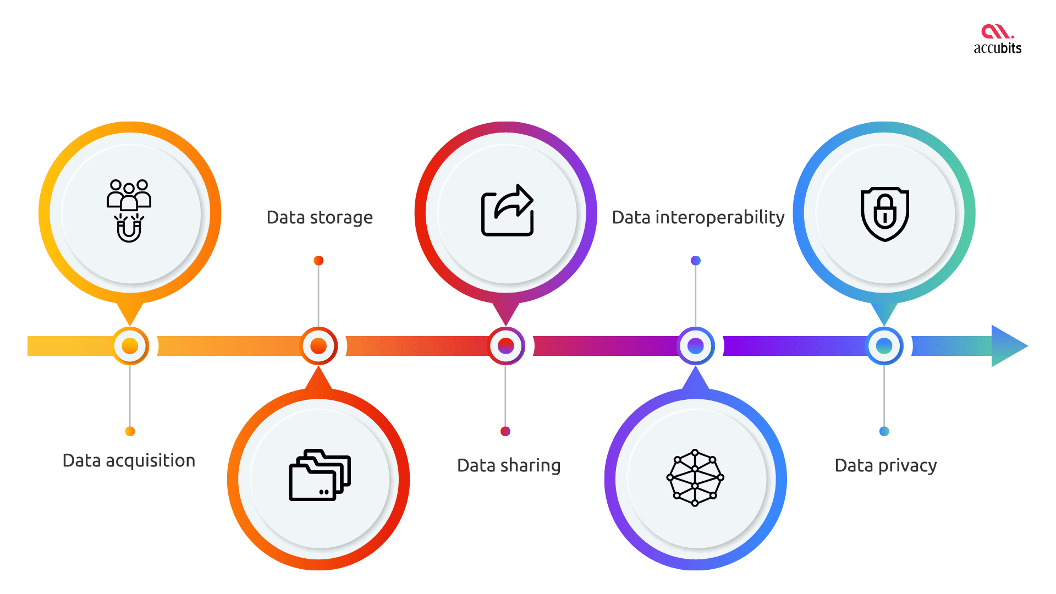
Technological Underpinnings of the Metaverse
Blockchain

Slide 12
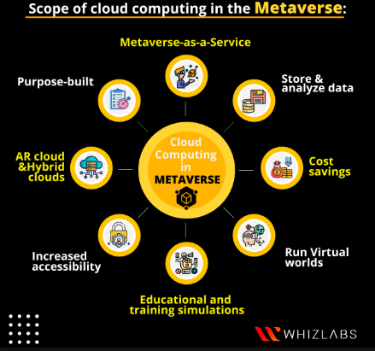
Technological Underpinnings of the Metaverse
Cloud computing

Slide 13
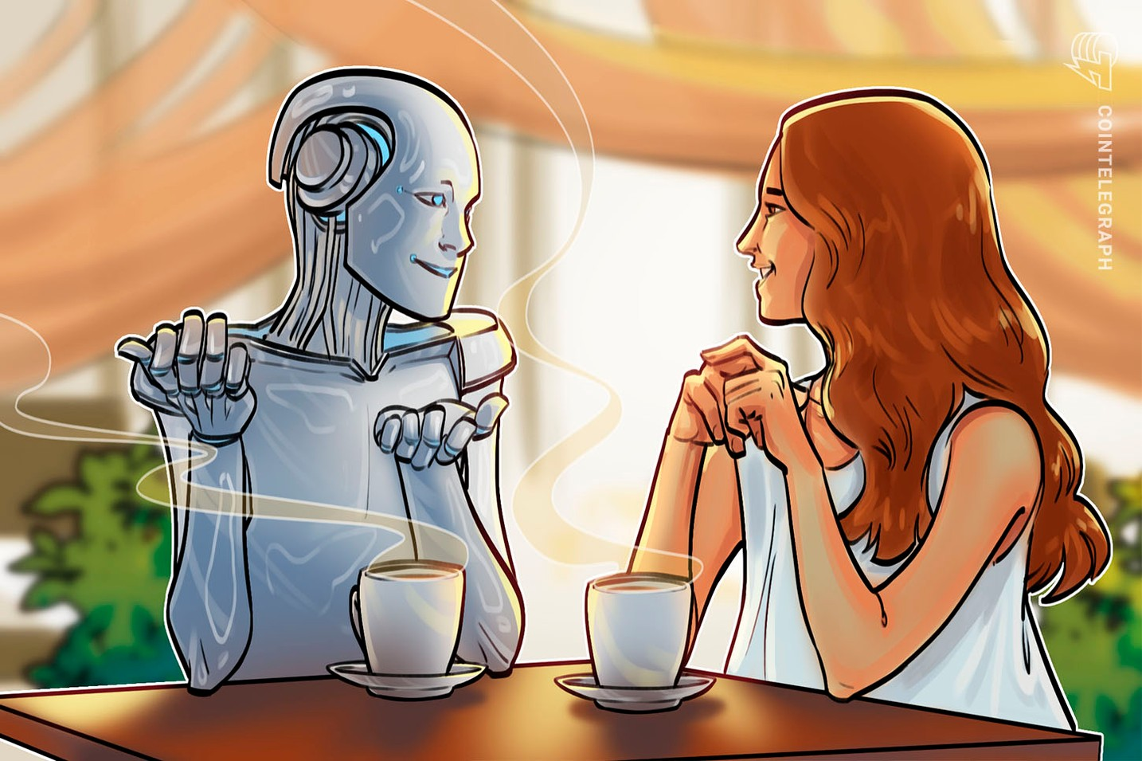
Technological Underpinnings of the Metaverse
artificial intelligence / natural language processing / spatial computing

Slide 14
Topics
Definition and Evolution of the Metaverse
History of the Metaverse
Technological Underpinnings of the Metaverse
How the Metaverse Works
Potential Applications of the Metaverse
Challenges and Opportunities of the Metaverse:

Slide 15
How the Metaverse Works
Create Avatar
Interact
Equipment -> really there
BlockChain -> safe transactions/buy and sell

Slide 16
Topics
Definition and Evolution of the Metaverse
History of the Metaverse
Technological Underpinnings of the Metaverse
How the Metaverse Works
Potential Applications of the Metaverse
Challenges and Opportunities of the Metaverse:

Slide 17
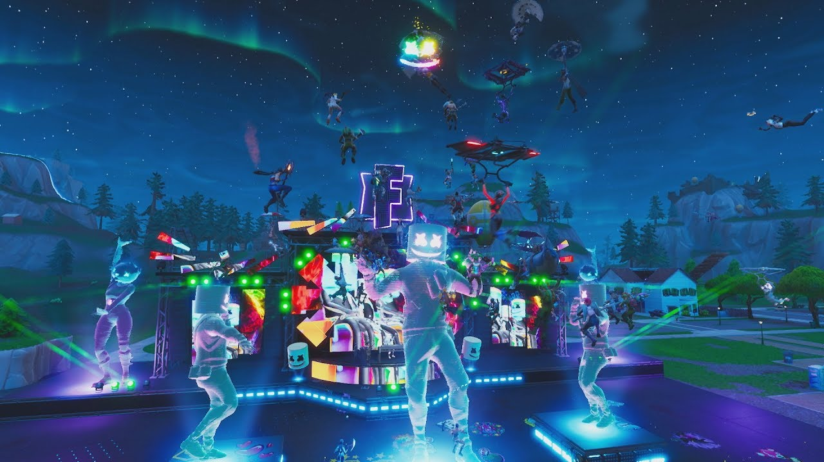
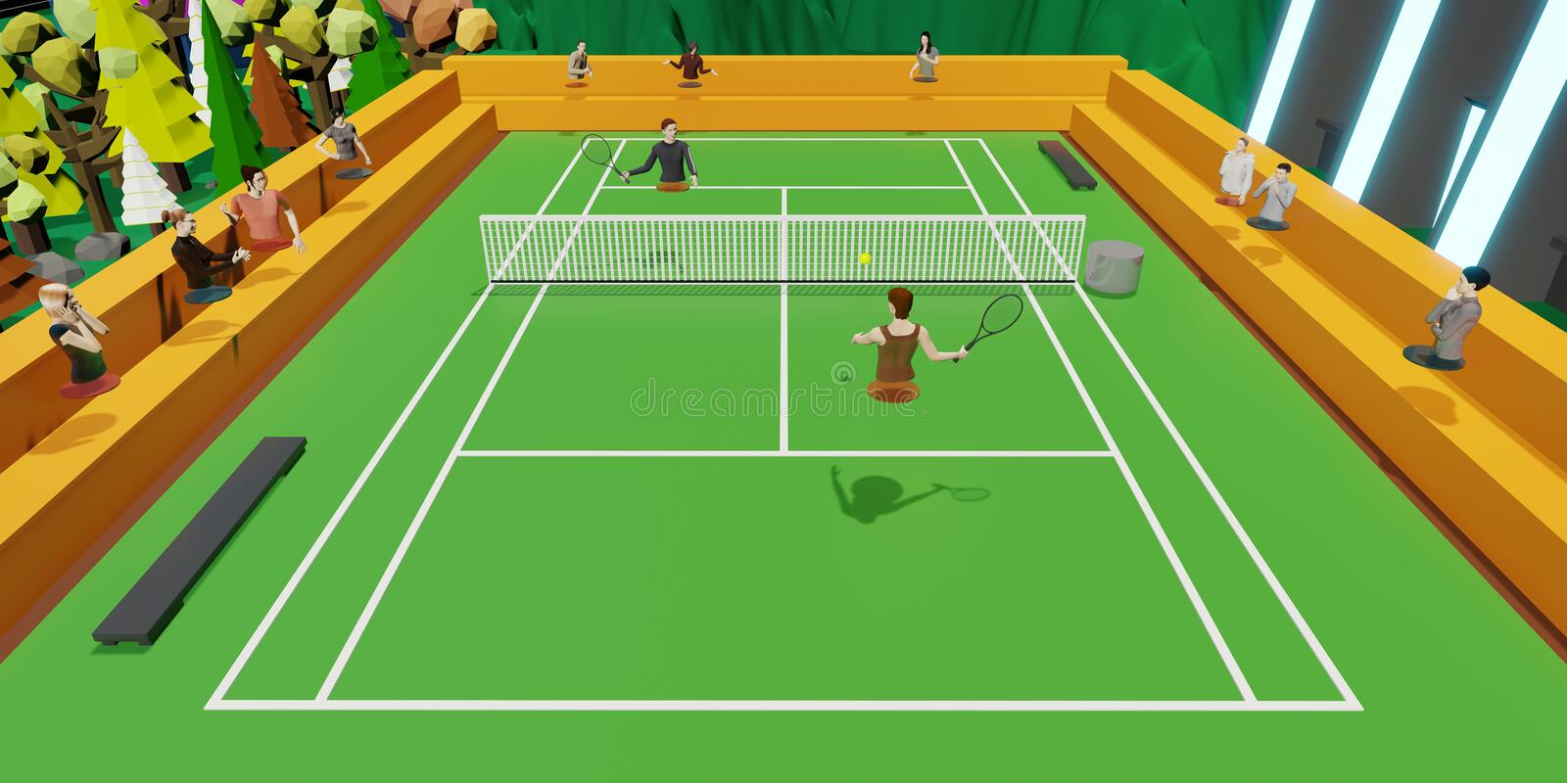
Potential Applications of the Metaverse
Entertainment -> Concerts, Sporting events, games ,movies

Slide 18
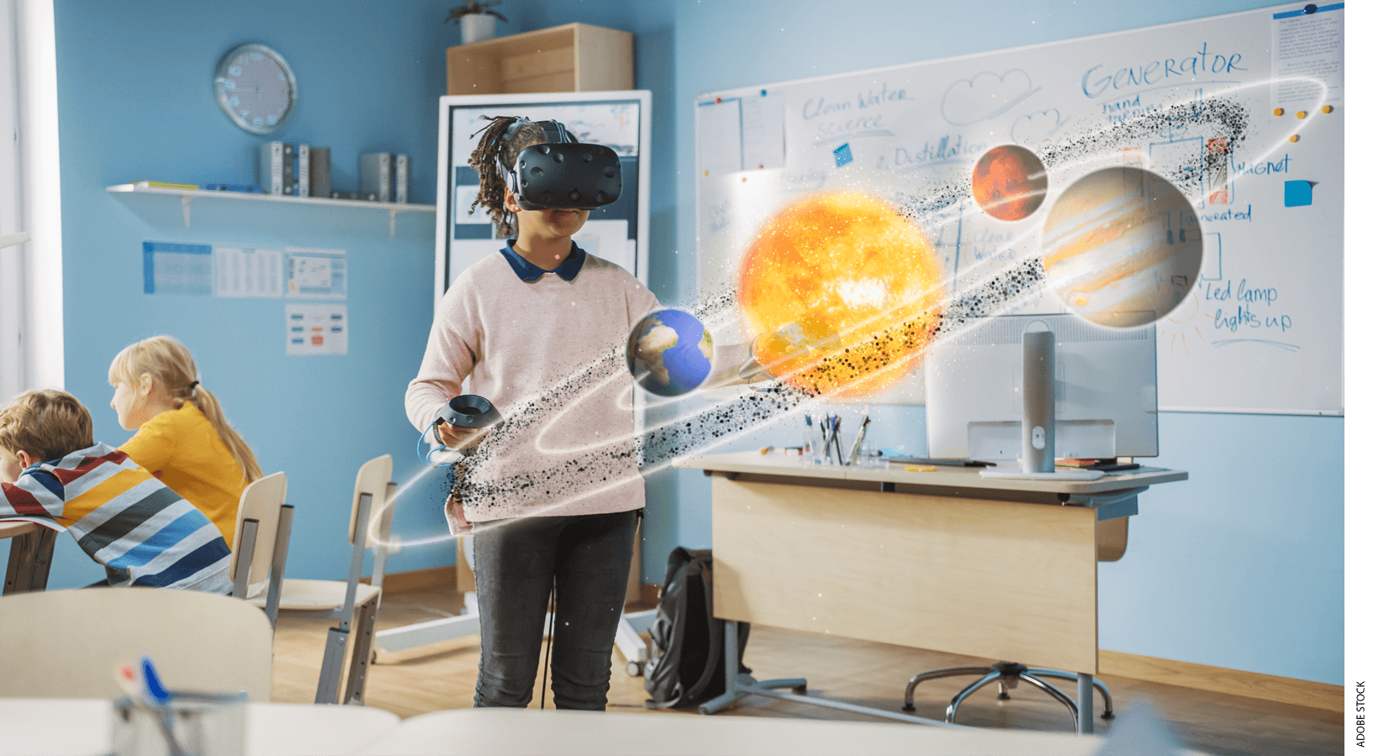
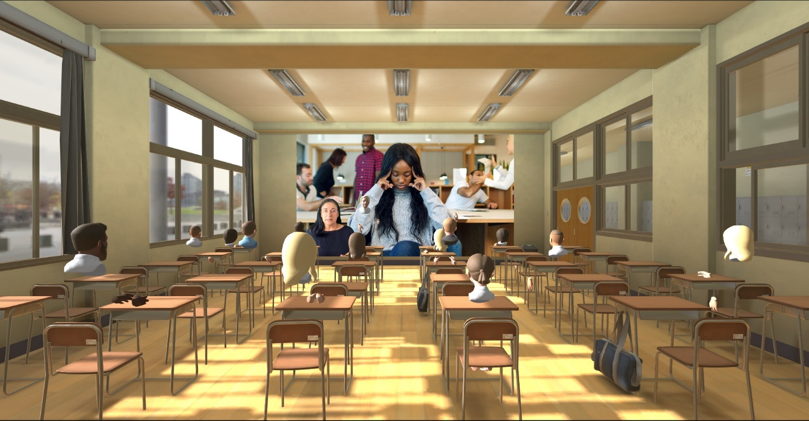
Potential Applications of the Metaverse
Education -> Virtual Classrooms

Slide 19
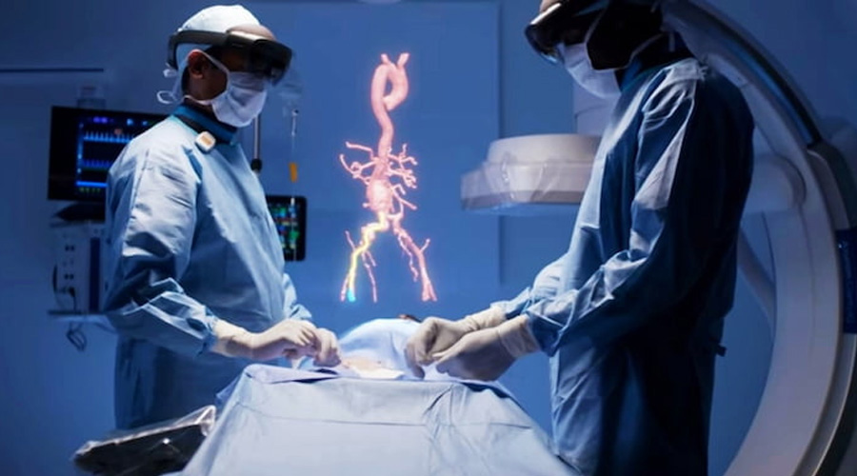
Potential Applications of the Metaverse
Healthcare -> Virtual therapy sessions, Support groups, medical training

Slide 20
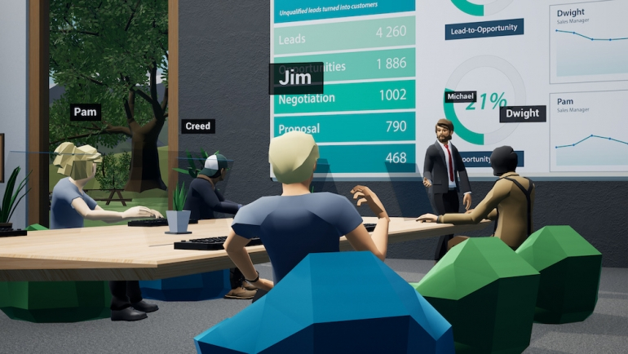
Potential Applications of the Metaverse
Business -> Virtual Offices, remote collaboration, virtual congerences

Slide 21
Topics
Definition and Evolution of the Metaverse
History of the Metaverse
Technological Underpinnings of the Metaverse
How the Metaverse Works
Potential Applications of the Metaverse
Challenges and Opportunities of the Metaverse

Slide 22
Challenges of the Metaverse
Technological challenges -> High speed Internet
Security -> lots of data!
Standards -> a lot of spaces -> same laws
Morality -> effects on culture
the potential for addiction and other negative psychological effects

Slide 23
Opportunities of the Metaverse
Economical -> Create new jobs and industries
New ways to communicate
Addressing global challenges
Growth of technology

Slide 24
conclusion
Rapidly growing
Potential for revolutionizing the way we interact
Keep a close eye and harness its potential for positive change.

